Slide 1

Electricity billing system
By
M.B.V.SAI KUMAR(190031075)
t. Sai PRANEETH(190031603)
V.SAI SIVA VARDHAN(190031731)

Slide 2

about
This project is a modern version of the traditional electricity billing system.
The focus of this project is to computerize the electricity billing system to make it more seamless, accessible, and efficient.
The software calculates the units consumed within a specific time duration and accordingly calculates the amount of money to be paid for those units.

Slide 3
modules
Login Module
User Module
Admin module
Units Module
Bills Module
Queries Module
Payment Module

Slide 4
Modules
Login Module
After registration, one can log in to the system as the end-user of the system on the behalf of the user. The user will get only those privileges that are given to the user for which one has registered.
User Module
The user can be anyone either a customer or an employee. If the user is an employee, then he can make changes to the data like adding units in the bill, used by a customer. If the user is a customer, then he can only see the details of his account, not of any other account. The customer can see the monthly usage of electricity and can pay the bill but cannot make any changes to the data.
Admin Module
This module can only have one account and this account has all the privileges which a user account might not have. First of all, the admin account is created, and then if the admin verifies a registering user, then his account will be created otherwise not.

Slide 5
Modules
Units Module
This module is used calculates the amount of money need to be paid by the customer.
Bills Module
In this, monthly bills can be sent to the customer’s account, any particular customer can be found using a unique meter id and the remaining balance of a customer can be checked.
Queries Module
In this module, the customer can ask any query he has and his question with his details will be sent to the person who is managing queries and then he or she can reply to the query of a customer. Admin can also see any query made by the customer and can also reply to the customer.
Payment Module
In this Module the customer can pay their electricity bills in online mode.

Slide 6

User stories
As a customer I would like to have the user interface to be good and user friendly manner since it will help the noraml people to understand the application/website in a better way.
As a admin i would like to manage the whole database of the project as per my own requirements and i must be able to alter every possible data in the database.
As a employee i must be able to view every transaction and bills of every customer so that i can interpret the whole data and generate a report.

Slide 7
User stories
As a customer i would like the billing system to be accessible every time irrespective time and date. There should be no complex interface that makes the user uncomfortable.
As a customer i would also like to have the application to have all the feature like viewing of the bill and the last date to pay the bill and all the remaining features that are provide in the electricity billing system.
As a employee I would like to access the details of the customer easily so that I can manage and solve the problems of the customer

Slide 8
System requirements
Software Requirements:
Windows 7/8/9/10
Spring tool suite
Oracle database
Hardware Requirements:
Processor – i3/i5/i7
Hard Disk – 1TB
Memory – 8GB RAM

Slide 9
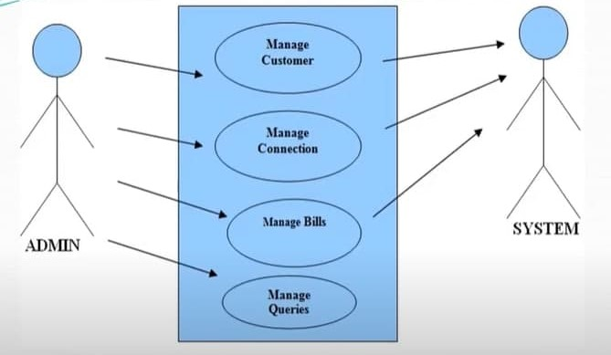
USE CASE DIAGRAM BETWEEN ADMIN AND SYSTEM

Slide 10
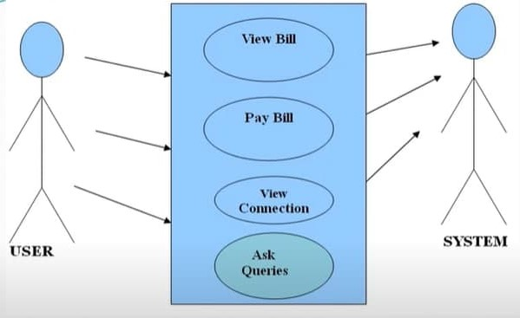
USE CASE DIAGRAM BETWEEN USER AND SYSTEM

Slide 11
Advantages and disadvantages
Advantages:
The system excludes the need of maintaining paper electricity bill as all the electricity bill records are managed electronically.
Administration doesn’t keep track a manual track of the users. The System automatically calculates the fine.
The System excludes manual bill calculation.
User don’t have to visit the office for bill payment.
Disadvantages:
User must have a reliable internet connection.
Users who don’t have idea on application will not understand the use of application.

Slide 12
Conclusion
It is software that helps the user to work with the billing cycles, paying bills, managing different departments under which employees are working, etc. This software reduces the amount of manual data entry and gives greater efficiency.
The User Interface of it is very friendly and can be easily used by anyone. It also decreases the amount of time taken to write details and other modules.

Slide 13



